Slide 1
Global Internal Audit Standards 2024 – What Audit Committees need to know
June 2024

Slide 2
Agenda
  The IPPF and Global Standards
  Key Changes and Areas of Challenge
  External Quality Assessments
  Audit Committee To Do List

Slide 3

Global Internal Audit Standards 2024, Domain III:
Appropriate governance arrangements are essential to enable the internal audit function to be effective.
…activities of the board [Audit Committee] …are essential to the internal audit function’s ability to fulfill the Purpose of Internal Auditing.

Slide 4
The IPPF and new Global Standards

Slide 5

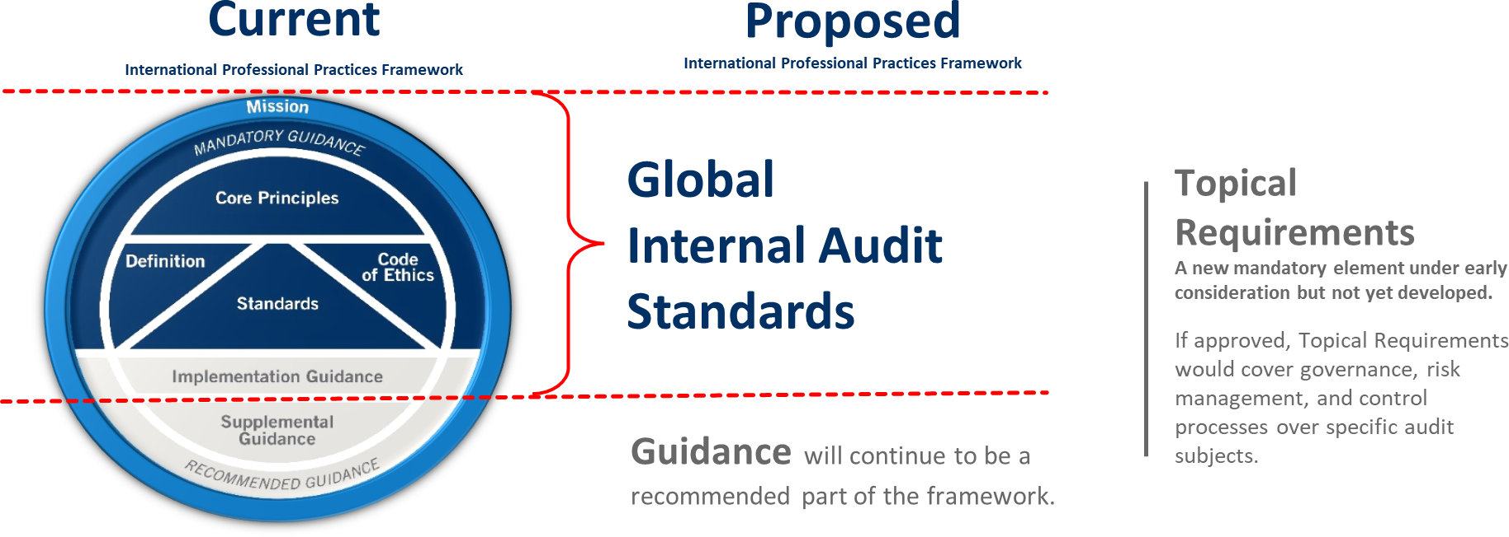
Current IPPF and Global Standards
Notes:
This slide shows how the existing International Professional Practice Framework (2017) maps to the new IPPF (2024).
The new Global Internal Audit Standards are essentially mapped to the mandatory requirements plus the Implementation Guidance of the 2017 IPPF.
The IPPF (2017) Supplemental and Recommended guidance, including GTAGs – remain and transfer to Guidance in the new IPPF 2024.
A new addition to the IPPF (2024) is the introduction of Topical Requirements – more on this later.

Slide 6
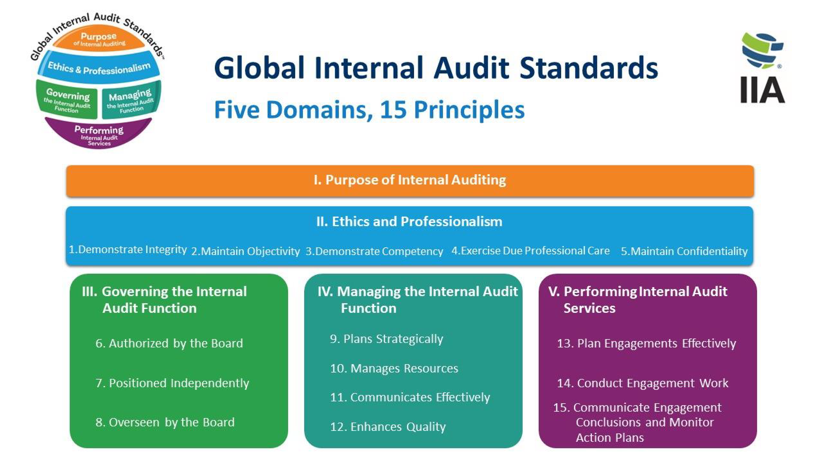
Notes:
Focusing on the new Global Standards 2024 this has a new structure.
There are 5 domains with the first two being the foundations which apply across all other domains. Then domain three is around Governing internal audit and therefore is the most relevant to the Audit Committee and includes essential conditions that the Audit Committee needs to follow. The fourth Domain is around leading the internal audit function and therefore is the focus of the Chief Audit Executive (aka the Head of Internal Audit). Finally domain 5 is focused on performing internal audit engagements.
Within each domain (except domain one) there are Principles – 15 in total, and under each principle are sets of standards with considerations for implementation (non-mandatory elements) and examples of evidence for conformance.
This new structure while meaning the document is now in the region of 100 pages long, is easy to dip in and out of and bring all relevant material to one place, rather than having to read across different documents.
The review has not just been structural. There are new requirements and clarifications. These are aimed to raise the barre for the profession across the globe., however, in the UK and Ireland (and EU) we do not envisage that the distance from current practice to the new Global Standards is as great as in other parts of the world.

Slide 7
Topical Requirements
Requirements when auditing the topics.
Recommended practices.
Applicable for a specific audit topic or engagement.
Covering aspects of governance, risk management, and control processes.
Cybersecurity – out for consultation until 3 July
Sustainability: ESG
Third Party Management
Information Technology Governance
Assessing organisational Governance
Fraud Risk Management
Privacy Risk Management
Public Sector: Performance Audits
Notes:
Topical Requirements are new.
The first of these is currently our for consultation until 3 July. The feedback from this will be used to establish a blue print for future topics.
As of yet therefore there is no clear instruction on how and when these are to be used.

Slide 8
Key Changes and Areas of Challenge

Slide 9
Glossary
There are some newly defined terms, and slight amends on others. The term ‘board’ used in the Global Standards is explained in full.
The term Board is a collective noun and is defined in the glossary as follows:
‘Highest-level body charged with governance, such as:
A board of directors.
An audit committee.
A board of governors or trustees.
A group of elected officials or political appointees.
Another body that has authority over the relevant governance functions.
In an organization that has more than one governing body, “board” refers to the body or bodies authorized to provide the internal audit function with the appropriate authority, role, and responsibilities.’
Notes:
It is really important to understand that the global Standards use the term Board as a collective noun for the governance structures in an organization. IN the Glossary they have defined and explained this. Therefore, when reading the Standards you should replace the word ‘Board’ with the name of your Committee that oversees internal audit. This might be Audit Committee, Risk and Audit Committee, Finance and Audit Committee. etc.
For the purposes of these slides we use the term Board for simplicity.

Slide 10
Domain I – Purpose of Internal Auditing
‘Internal auditing strengthens the organization’s ability to create, protect, and sustain value by providing the board and management with independent, risk-based, and objective assurance, advice, insight, and foresight.’
Internal auditing enhances the organization’s:
Successful achievement of its objectives.
Governance, risk management, and control processes.
Decision-making and oversight.
Reputation and credibility with its stakeholders.
Ability to serve the public interest.
Notes:
Insight and Foresight is an interesting term and Audit Committees can discuss what this means for them, their organization and internal audit function. Questions that you may wish to consider is how is insight and foresight created by the internal audit function and how is this shared and used by the board?
In addition, Domain One provides a focus around public interest. This is easier to understand and consider in a public sector organization or a charity, but what does this mean for a commercial organization. Again this should be an area of discussion for the board.

Slide 11
Domain III – Governing the Internal Audit Function
Board/Audit Committee now have to conform with the Essential Requirements included in the Domain, as well as the Principles and Standards. The following is a summary of these:
Discussion of Domains I & III of the new global standards at audit committee is required
The internal audit mandate (documented within the Charter) is to be discussed with the CAE and Senior Management and approved by the Board when presented by the CAE.
The Board must advocate and champion the internal audit function to support its purpose and enable it to pursue its strategy and objectives. This includes
  working with senior management,
  supporting the CAE through regular communication; ensuring that the CAE reports to an appropriate level; approving the mandate, charter, strategy and internal audit plan, budget and resource plan; and
  ensures internal audits authority has not been compromised or limited and meeting with the CAE privately.
Notes:
Discussion of Domains I & III of the new global standards at audit committee is required and should be added to the board agenda. The frequency of the discussion is not determined, but must take place at any time there is a significant change.
The internal audit mandate (documented within the Charter) is to be discussed with the CAE and Senior Management and approved by the board when presented by the CAE. Again this should be revisited when the there is a significant change. We would recommend that changes / additions to the global standards would be reason to do this as well as significant changes in the organisation’s structure or purpose. Similarly the internal audit charter as a whole should be discussed and approved by the board.
The board must advocate and champion the internal audit function to support its purpose and pursue its strategy and objectives. This includes working with senior management, supporting the CAE through: regular communication; ensuring that the CAE reports to an appropriate level; approving the mandate, charter, strategy and internal audit plan, budget and resource plan; and ensures internal audits authority has not been compromised or limited and meeting with the CAE privately.
Here the approval of the budget by the board may be a challenge as this typically falls within an organization's standard budgeting processes. However, an inadequate budget can create limitations for the level of assurance an internal audit function can provided. In this instance it would be expected that the board would discuss this with the approving governance committee and Finance Director (or equivalent) to champion the internal audit functions needs. This may never of course be possible in certain sectors, for example the public sector, and therefore where it is not it is very important to ensure the limitation and their implications are discussed and understood by the board.

Slide 12
Domain III – Governing the Internal Audit Function
Principle 7 – Positioned Independently
‘The internal audit function is only able to fulfill the Purpose of Internal Auditing when the chief audit executive reports directly to the board, is qualified, and is positioned at a level within the organization that enables the internal audit function to discharge its services and responsibilities without interference.’
Notes:
Reporting
The board must establish a direct reporting relationship with the chief audit executive and the internal audit function
Qualified
The board must be active in determining the role, responsibility, qualifications and experience of the CAE and in their appointment, development, remuneration and appraisal of their performance.
Essentially the board may not perform the appraisal of the CAE but they should provide input to senior management to support the performance evaluation and remuneration of the chief audit executive.
The board must authorize the appointment and removal of the chief audit executive. Again this may not be possible in certain sectors. For outsource models, this approval and removal forms part of any tender process and for shared services boards should still provide the shared service organization with a role profile of the individual they feel would best meet their needs.
Position
Require that the chief audit executive be positioned at a level in the organization that enables internal audit services and responsibilities to be performed without interference from management. This positioning provides the organizational authority and status to bring matters directly to senior management and escalate matters to the board when necessary. For example you would not expect the CAE to report to the Head of Risk for Administrative purposes.
Provide the chief audit executive with opportunities to discuss significant and sensitive matters with the board, including meetings without senior management present.
Help safeguard the independence and objectivity and prevent impairment to these. Where this does occur or is perceived to have occurred then the Board must discuss with the CAE and senior management and evaluate the impact on the purpose and work of the internal audit function.

Slide 13
Domain III – Governing the Internal Audit Function
Principle 8 – Overseen by the Board
This considers the mechanics of the interactions between the CAE and the Board. It gives the Board’s essential conditions as
Understanding how IA is fulfilling its mandate
Explaining the boards perspective on organisation’s strategy, risks, to help determine IA priorities
Frequency of communications being agreed
Escalation protocols and criteria
Conclude on the organisations governance, risk and internal control based on the reports from IA
Discuss differences of opinion on audit findings to support the IA mandate being achieved.
Notes:
A lot of these requirements are best practice already in the UK, Ireland and the EU. However, it can be a helpful to review these arrangements and ensure that they are fulfilling their purpose.

Slide 14
Domain III – Governing the Internal Audit Function
Principle 8 – Overseen by the Board
Support the discussions and decisions around resourcing IA in order for it to fulfil its mandate, and issues due to a lack of resources.
Discuss and support the Quality Assurance and Improvement Programme, and assess the effectiveness and efficiency of the IA function (conformance and performance)
Discuss and approve the IA’s performance objectives annually
External Quality Assessment involvement from discussion of the plan, helping to determine scope and frequency, review and approve the plan for the EQA. Receive the full results from the EQA and review and approve the resulting action plan along with timelines to complete and monitor progress.
Notes:
For EQAs it is important that the board is actively involved. This a means by which you received independent assurance that you can rely on the internal audit function and therefore fulfil your duties and responsibilities. The board is here to govern the internal audit function and therefore it is important that the board is actively involved in the tools that help them to do this.

Slide 15
Domain III – Governing the Internal Audit Function
Global Standards 2024
IPPF 2017 Standards
Internal Audit Mandate - ‘The internal audit function’s authority, role, and responsibilities, which may be granted by the board and/or laws and/or regulations.’
Internal Audit Charter – ‘A formal document that includes the internal audit function’s mandate, organizational position, reporting relationships, scope of work, types of services, and other specifications.
‘The internal audit charter is a formal document that defines the internal audit activity's purpose, authority, and responsibility. The internal audit charter establishes the internal audit activity's position within the organization; authorizes access to records, personnel, and physical properties relevant to the performance of engagements; and defines the scope of internal audit activities.​
Notes:
Internal Audit Mandate is a new term in the new global internal audit standards.
While the mandate can be aspirational in nature, when you compare the definitions from the 2017 IPPF to that of the new 2024 IPPF you can see that the Mandate is already defined in existing Charters. You may wish to review and push on the elements that form the mandate to include an element of aspiration.

Slide 16
Other Key changes
Domain II – Essentially the Code of Ethics with some further expansion pulling from Implementation Guidance. Introduction of the term ‘Professional Courage’ and ethics training as a consideration for implementation, but CIAs MUST complete 2 CPEs of ethics training every year. Also ‘professional courage’ as an appraisal objective.
Domain IV – The Internal Strategy Principle sits in here, and the need to develop and implement an internal audit strategy.
Domain V – This is largely the same as the IPPF. The term root cause in here has been an area of discussion amongst internal auditors.
Notes:
Professional Courage is a new term. This is not about internal auditors seeking to speak direct with the board on areas they are worried about, but having professional discussion and using escalation protocols as appropriate to ensure that the message reaches the board as appropriate. Part of this is about ensuring that internal audit functions are aware of what ethical standards are expected, which is why ethical training is key part of this.
The internal audit strategy is new and is not the list of internal audit engagements. The board is required to review, approve and monitor this. Some internal audit functions already have this in place but it may have not come to the board as it was not required under the 2017 IPPF. We would expect this to be in place for the implementation date in January 2025.
The final domain is all about performing internal audit engagements. This is very largely the same as the 2017 IPPF. There is a drive in here, however, to ensure that actions agreed as the result of internal audit activity are aimed to the correct level and place in the finding – the root cause. This means that you should not see recommendations such as ‘Remind staff to follow the procedure….’ or ‘Consider putting together a project on….’ these are weak and are not addressing root causes.

Slide 17
External Quality Assessments

Slide 18
External Quality Assessments
If your assessment is due in 2024 then you can:
Have an EQA against the existing IPPF
Request an additional piece of work against the new global standards (a readiness assessment)
If your assessment is due in 2025 then you can:
Bring your EQA forward so it is done against the existing IPPF, but this must be reported before January 2025.
Keep your EQA to the current deadline and it will need to be done against the new Global Standards if after 9 January 2025
Note: If you are not going to adopt the new global Standards until 9 January / April 2025 then you need to allow sufficient time for you to have completed engagements using the new Standards before your EQA is undertaken. Therefore the due date may impact on your decision.
Notes:
Talk through the slide.

Slide 19




Questions?
Contact us for further information on;
Follow us on social media
Membership services
membership@iia.org.uk
@CharteredIIA
Training courses including online
learning@iia.org.uk
Chartered Institute of Internal Auditors
Career pathway and designations
studentsupport@iia.org.uk
@CharteredIIA
CharteredIIA

Slide 20
Thank you

