Slide 1
Global Internal Audit Standards 2024 – What Senior Management need to know
June 2024

Slide 2
Agenda
  The IPPF and Global Standards
  Key Changes and Areas of Challenge
  External Quality Assessments
  Audit Committee To Do List

Slide 3

Global Internal Audit Standards 2024, Domain III:
Appropriate governance arrangements are essential to enable the internal audit function to be effective.
…activities of… Senior Management are essential to the internal audit function’s ability to fulfill the Purpose of Internal Auditing.

Slide 4
The IPPF and new Global Standards

Slide 5

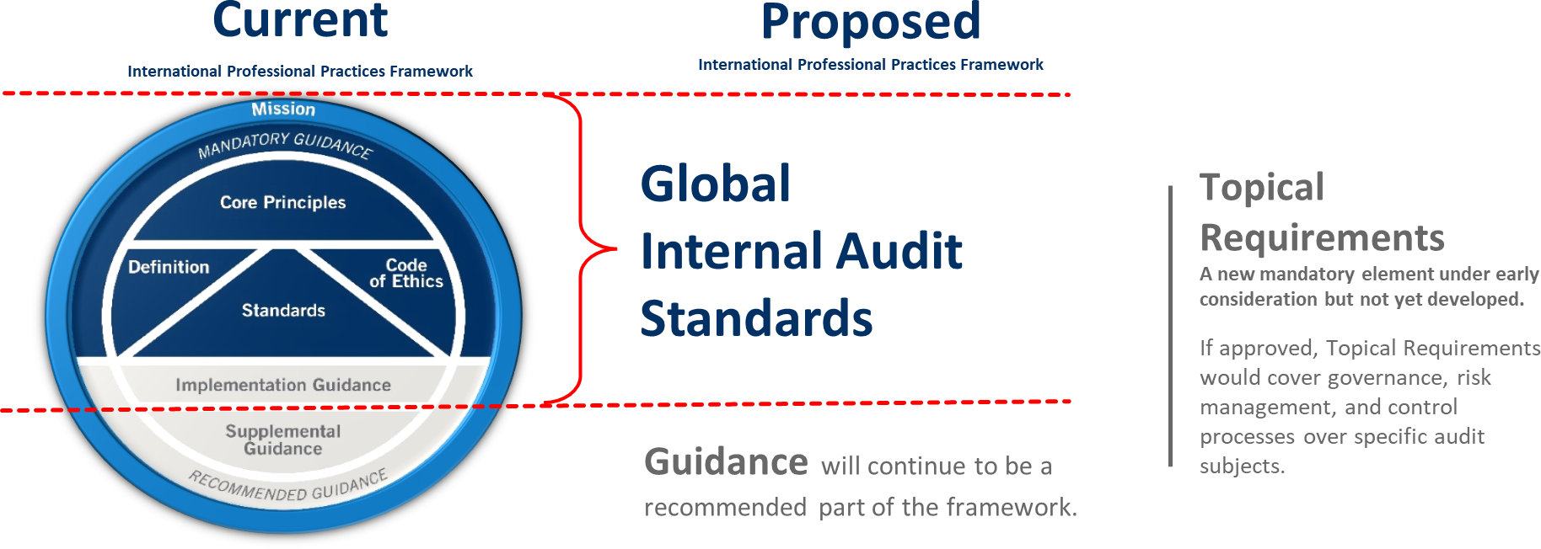
Current IPPF and Global Standards
Notes:
This slide shows how the existing International Professional Practice Framework (2017) maps to the new IPPF (2024).
The new Global Internal Audit Standards are essentially mapped to the mandatory requirements plus the Implementation Guidance of the 2017 IPPF.
The IPPF (2017) Supplemental and Recommended guidance, including GTAGs – remain and transfer to Guidance in the new IPPF 2024.
A new addition to the IPPF (2024) is the introduction of Topical Requirements – more on this later.

Slide 6
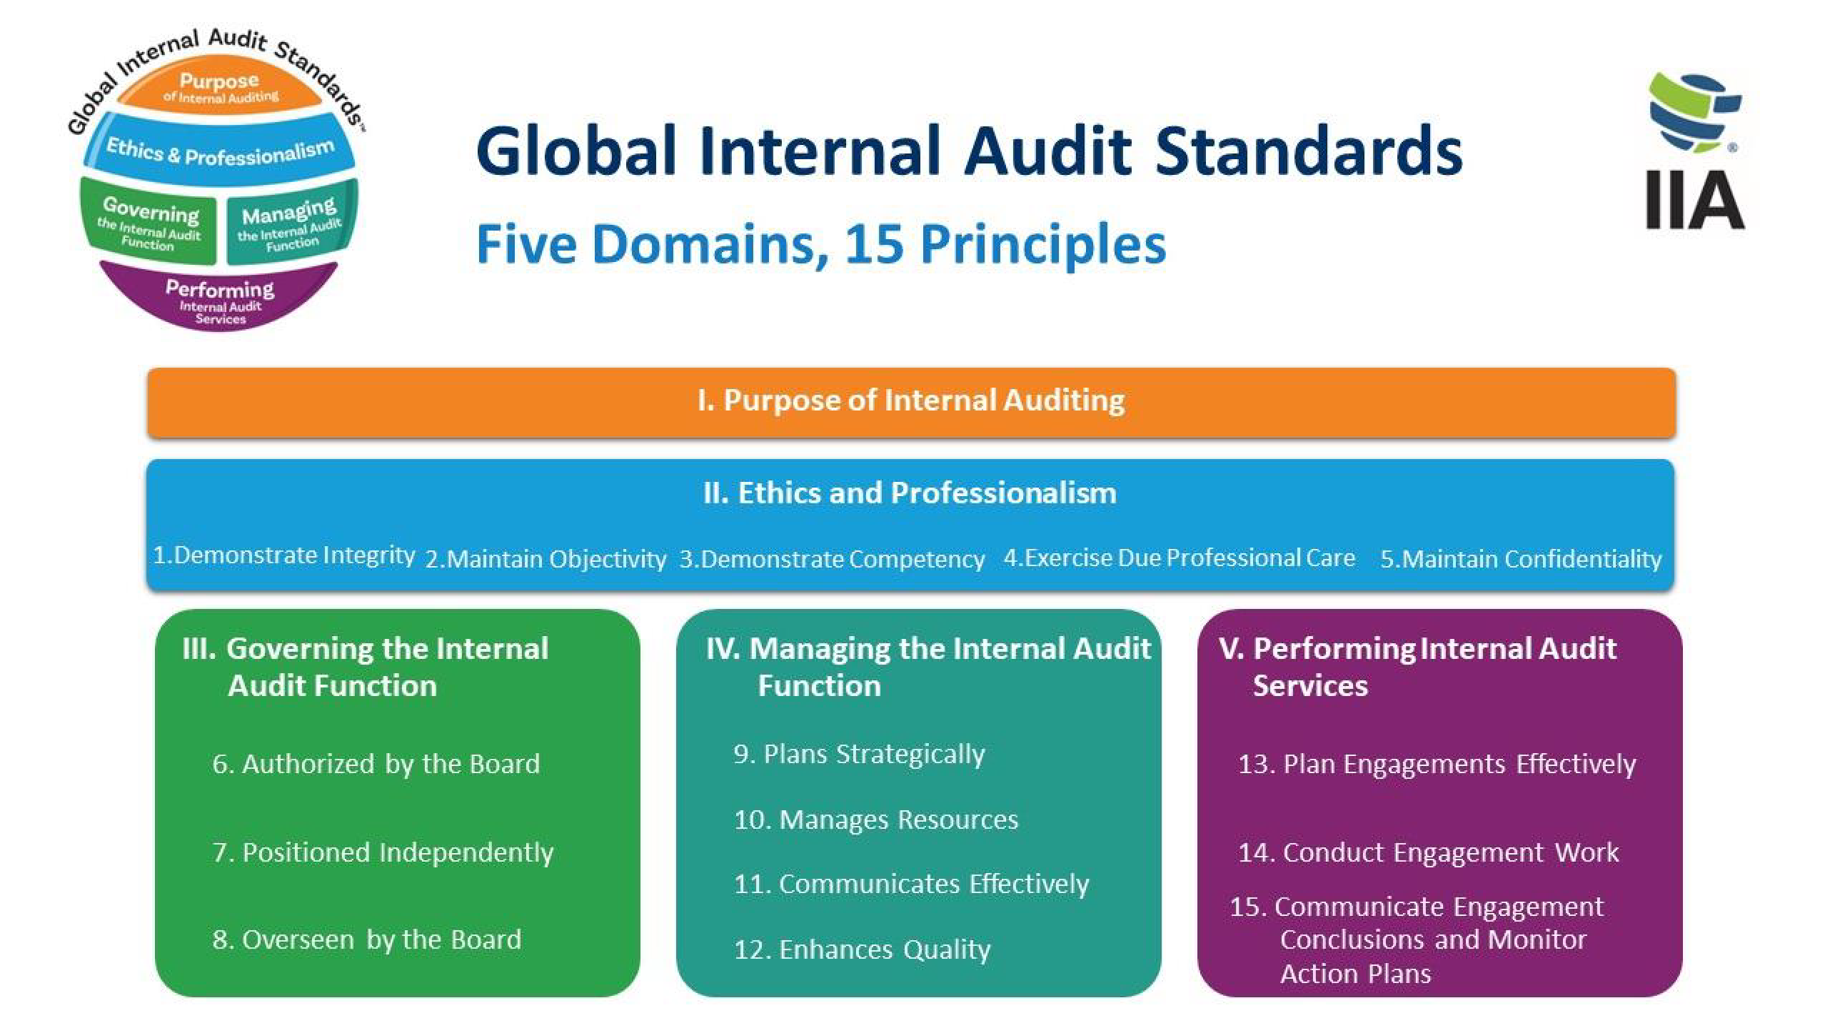
Notes:
Focusing on the new Global Standards 2024 this has a new structure.
There are 5 domains with the first two being the foundations which apply across all other domains. Then domain three is around Governing internal audit and therefore is the most relevant to Senior Management and includes essential conditions that Senior Management need to follow. The fourth Domain is around leading the internal audit function and therefore is the focus of the Chief Audit Executive (aka the Head of Internal Audit). Finally domain 5 is focused on performing internal audit engagements.
Within each domain (except domain one) there are Principles – 15 in total, and under each principle are sets of standards with considerations for implementation (non-mandatory elements) and examples of evidence for conformance.
This new structure while meaning the document is now in the region of 100 pages long, is easy to dip in and out of and bring all relevant material to one place, rather than having to read across different documents.
The review has not just been structural. There are new requirements and clarifications. These are aimed to raise the barre for the profession across the globe., however, in the UK and Ireland (and EU) we do not envisage that the distance from current practice to the new Global Standards is as great as in other parts of the world.

Slide 7
Topical Requirements
Requirements when auditing the topics.
Recommended practices.
Applicable for a specific audit topic or engagement.
Covering aspects of governance, risk management, and control processes.
Cybersecurity – out for consultation until 3 July
Sustainability: ESG
Third Party Management
Information Technology Governance
Assessing organisational Governance
Fraud Risk Management
Privacy Risk Management
Public Sector: Performance Audits
Notes:
Topical Requirements are new.
The first of these is currently our for consultation until 3 July. The feedback from this will be used to establish a blue print for future topics.
As of yet therefore there is no clear instruction on how and when these are to be used.

Slide 8
Key Changes and Areas of Challenge

Slide 9
Glossary
There are some newly defined terms, and slight amends on others. The term ‘board’ used in the Global Standards is explained in full.
The term Board is a collective noun and is defined in the glossary as follows:
‘Highest-level body charged with governance, such as:
A board of directors.
An audit committee.
A board of governors or trustees.
A group of elected officials or political appointees.
Another body that has authority over the relevant governance functions.
In an organization that has more than one governing body, “board” refers to the body or bodies authorized to provide the internal audit function with the appropriate authority, role, and responsibilities.’
Notes:
It is really important to understand that the global Standards use the term Board as a collective noun for the governance structures in an organization. IN the Glossary they have defined and explained this. Therefore, when reading the Standards you should replace the word ‘Board’ with the name of your Committee that oversees internal audit. This might be Audit Committee, Risk and Audit Committee, Finance and Audit Committee. etc.
For the purposes of these slides we use the term Board for simplicity.

Slide 10
Domain I – Purpose of Internal Auditing
‘Internal auditing strengthens the organization’s ability to create, protect, and sustain value by providing the board and management with independent, risk-based, and objective assurance, advice, insight, and foresight.’
Internal auditing enhances the organization’s:
Successful achievement of its objectives.
Governance, risk management, and control processes.
Decision-making and oversight.
Reputation and credibility with its stakeholders.
Ability to serve the public interest.
Notes:
Insight and Foresight is an interesting term and Heads of Internal Audit can discuss with Senior Management what this means for them, their organization and internal audit function. Questions that you may wish to consider is how is insight and foresight created by the internal audit function and how is this shared and used by senior management?
In addition, Domain One provides a focus around public interest. This is easier to understand and consider in a public sector organization or a charity, but what does this mean for a commercial organization. Again this should be an area of discussion between the Head of Internal Audit and Senior Management.

Slide 11
Domain III – Governing the Internal Audit Function
Senior Management Essential Requirements are:
Discussion of Domains I & III of the new global standards is required
Participate in discussions with the board and chief audit executive and provide input on expectations for the internal audit function that the board should consider when establishing the internal audit mandate.
Support the internal audit mandate throughout the organization and promote the authority granted to the internal audit function.
Communicate with the board and chief audit executive about management’s expectations that should be considered for inclusion in the internal audit charter.
Support recognition of the internal audit function throughout the organization.
Work with the board and management throughout the organization to enable the internal audit function’s unrestricted access to the data, records, information, personnel, and physical properties necessary to fulfill the internal audit mandate.
Notes:
Discussion of Domains I & III of the new global standards . The frequency of the discussion is not determined, but must take place at any time there is a significant change.
The internal audit mandate (documented within the Charter) is to be discussed with the CAE and Senior Management and approved by the board when presented by the CAE. Again this should be revisited when the there is a significant change. We would recommend that changes / additions to the global standards would be reason to do this as well as significant changes in the organisation’s structure or purpose. Similarly the internal audit charter as a whole should be discussed and approved by the board.
Senior Management must support the internal audit function by ensuring that it has the information and access for it to perform its role.

Slide 12
Domain III – Governing the Internal Audit Function
Principle 7 – Positioned Independently
‘The internal audit function is only able to fulfill the Purpose of Internal Auditing when the chief audit executive reports directly to the board, is qualified, and is positioned at a level within the organization that enables the internal audit function to discharge its services and responsibilities without interference.’
Notes:
Reporting
The board must establish a direct reporting relationship with the chief audit executive and the internal audit function
Qualified
The board must be active in determining the role, responsibility, qualifications and experience of the CAE and in their appointment, development, remuneration and appraisal of their performance.
Essentially the board may not perform the appraisal of the CAE but they should provide input to senior management to support the performance evaluation and remuneration of the chief audit executive.
The board must authorize the appointment and removal of the chief audit executive. Again this may not be possible in certain sectors. For outsource models, this approval and removal forms part of any tender process and for shared services boards should still provide the shared service organization with a role profile of the individual they feel would best meet their needs.
Position
Require that the chief audit executive be positioned at a level in the organization that enables internal audit services and responsibilities to be performed without interference from management. This positioning provides the organizational authority and status to bring matters directly to senior management and escalate matters to the board when necessary. For example you would not expect the CAE to report to the Head of Risk for Administrative purposes.
Provide the chief audit executive with opportunities to discuss significant and sensitive matters with the board, including meetings without senior management present.
Help safeguard the independence and objectivity and prevent impairment to these. Where this does occur or is perceived to have occurred then the Board must discuss with the CAE and senior management and evaluate the impact on the purpose and work of the internal audit function.

Slide 13
Domain III – Governing the Internal Audit Function
Principle 7 – Positioned Independently
Senior Management Essential Requirements are:
Position the internal audit function at a level within the organization that enables it to perform its services and responsibilities without interference, as directed by the board.
Recognize the chief audit executive’s direct reporting relationship with the board.
Engage with the board and the chief audit executive to understand any potential impairments to the internal audit function’s independence caused by non-audit roles or other circumstances and support the implementation of appropriate safeguards to manage such impairments.
Provide input to the board on the appointment and removal of the chief audit executive.
Solicit input from the board on the performance evaluation and remuneration of the chief audit executive.
Engage with the board to determine the chief audit executive’s qualifications, experience, and competencies.
Enable the appointment, development, and remuneration of the chief audit executive through the organization’s human resources processes.
Notes:
Administrative reporting lines have always been an area for discussion and change as they need to support the independence of the internal audit function. Ideally the Head of Internal Audit should not report to any member of senior management where the internal audit function is providing assurance over.
Non-audit roles can also be a challenge in times when there are financial constraints. Heads of Internal Audit can also have responsibility for Risk Management, Fraud investigations and other areas which are not internal audit focused. Safeguards are needed to ensure that there is no actual or perceived conflict of interest in the assurance framework as a result.
Ultimately the Standards now state that the Audit Committee is responsible for the hire and removal of the Head of Internal Audit and not senior management. However, the performance review of the Head of Internal Audit can lie within Senior Management with the input of the Audit Committee.

Slide 14
Domain III – Governing the Internal Audit Function
Principle 8 – Overseen by the Board
This considers the mechanics of the interactions between Senior Management, the Board and Head of Internal Audit. It gives Senior Management’s essential conditions as:
Communicate senior management’s perspective on the organization’s strategies, objectives, and risks to assist the chief audit executive with determining internal audit priorities.
Assist the board in understanding the effectiveness of the organization’s governance, risk management, and control processes.
Work with the board and the chief audit executive on the process for escalating matters of importance to the board.
Engage with the board to provide the internal audit function with sufficient resources to fulfill the internal audit mandate and achieve the internal audit plan.
Engage with the board and the chief audit executive on any issues of insufficient resources and how to remedy the situation.
Notes:
A lot of these requirements are best practice already in the UK, Ireland and the EU. However, it can be a helpful to review these arrangements and ensure that they are fulfilling their purpose.
Senior Management need to be active in the discussions around the organizations strategy and risks to help both the Head of Internal Audit and the Audit Committee understand their perspective, concerns etc. This three way discussion supports internal audit is being able to provide assurance on things that matter and provide advice to senior management. Senior Management should also engage in the escalation of issus to the audit committee, where it can be evaluated and solutions agreed within the governance of the organization and enables the audit committee to fulfil its remit delegated to it by the Board.
Resourcing of internal audit can be very challenging as it is a cost centre and an area which does not directly contribute to the bottom line. However Senior Management need to participate in the conversations around resource constraints for internal audit and understand the implications as a result of this for the governance of the organization and any legal / regulatory obligations of the governance. Audit Committees may well feel uneasy about providing annual assurance opinions and similar, if they feel the internal audit function has been constrained in what assurance it can provide due to resourcing constraints.

Slide 15
Domain III – Governing the Internal Audit Function
Principle 8 – Overseen by the Board
Essential Conditions continued…
Provide input on the internal audit function’s performance objectives.
Participate with the board in an annual assessment of the chief audit executive and internal audit function.
Collaborate with the board and the chief audit executive to determine the scope and frequency of the external quality assessment.
Review the results of the external quality assessment, collaborate with the chief audit executive and board to agree on action plans that address identified deficiencies and opportunities for improvement, if applicable, and agree on a timeline for completion of the action plans.
Notes:
Senior Management will have expectations of internal audit, as they are a key stakeholder and receiver of the assurance generated. Therefore, senior management must be active in expressing those expectations and how this translates into performance objectives of the internal audit function. This does connect through to the Internal Audit Strategy (Principle 9 in Domain IV Managing the Internal Audit Function)
Senior management also need to be involved in the assessment of the Head of Internal Audit but also of the wider function and the service it delivers. This assessment can be performed through internal activities, but also through the EQA performed at a minimum of every 5 years. The EQA is an extremely valuable activity which provides independent and objective assurance over the internal audit function – an audit of internal audit if you will. As a key stakeholder in the internal audit function, therefore, it is easy to understand why senior management should be actively involved in the EQA scoping, planning and the subsequent report and action plans.

Slide 16
Domain III – Governing the Internal Audit Function
Global Standards 2024
IPPF 2017 Standards
Internal Audit Mandate - ‘The internal audit function’s authority, role, and responsibilities, which may be granted by the board and/or laws and/or regulations.’
Internal Audit Charter – ‘A formal document that includes the internal audit function’s mandate, organizational position, reporting relationships, scope of work, types of services, and other specifications.
‘The internal audit charter is a formal document that defines the internal audit activity's purpose, authority, and responsibility. The internal audit charter establishes the internal audit activity's position within the organization; authorizes access to records, personnel, and physical properties relevant to the performance of engagements; and defines the scope of internal audit activities.​
Notes:
Internal Audit Mandate is a new term in the new global internal audit standards.
While the mandate can be aspirational in nature, when you compare the definitions from the 2017 IPPF to that of the new 2024 IPPF you can see that the Mandate is already defined in existing Charters. You may wish to review and push on the elements that form the mandate to include an element of aspiration.

Slide 17
Other Key changes
Domain II – Essentially the Code of Ethics with some further expansion pulling from Implementation Guidance. Introduction of the term ‘Professional Courage’ and ethics training as a consideration for implementation, but CIAs MUST complete 2 CPEs of ethics training every year. Also ‘professional courage’ as an appraisal objective.
Domain IV – The Internal Strategy Principle sits in here, and the need to develop and implement an internal audit strategy.
Domain V – This is largely the same as the 2017 IPPF. The term root cause in here has been an area of discussion amongst internal auditors.
Notes:
Professional Courage is a new term. This is not about internal auditors seeking to speak direct with the board or senior management on areas they are worried about, but having professional discussion and using escalation protocols as appropriate to ensure that the message reaches senior management as appropriate. Part of this is about ensuring that internal audit functions are aware of what ethical standards are expected, which is why ethical training is key part of this.
The internal audit strategy is new and is not the list of internal audit engagements. This needs to be developed with input from Senior Management. Some internal audit functions already have this in place but it may not have been as significant as is now required in the Standards. We would expect this to be in place for the implementation date in January 2025.
The final domain is all about performing internal audit engagements. This is very largely the same as the 2017 IPPF. There is a drive in here, however, to ensure that actions agreed as the result of internal audit activity are aimed to the correct level and place in the finding – the root cause. This means that you should not see recommendations such as ‘Remind staff to follow the procedure….’ or ‘Consider putting together a project on….’ these are weak and are not addressing root causes.

Slide 18




Questions?
Contact us for further information on;
Follow us on social media
Membership services
membership@iia.org.uk
@CharteredIIA
Training courses including online
learning@iia.org.uk
Chartered Institute of Internal Auditors
Career pathway and designations
studentsupport@iia.org.uk
@CharteredIIA
CharteredIIA

Slide 19
Thank you

